Slide 1

YAY! - Celebrating Education

Slide 2

Welcome to the YAY's Python Course
(Basics)

Slide 3
Day 3

Slide 4
Course Agenda for Today?
Day 2 Sample Greetings Problem Discussion
Conditionals in Python
if statement
Ternary Operator
Logical Operators
Boolean Algebra
in and pass Operators
For Loops (Intuition)
Python Lists

Slide 5
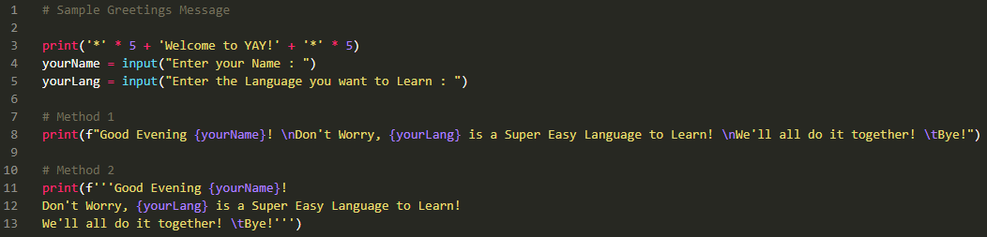
Day 2 Sample Greetings Problem Discussion

Slide 6
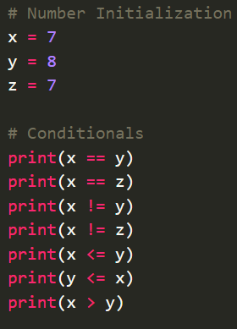
Python Conditionals (Comparison)
Python supports the usual comparison conditions from Mathematics:
Equals: a == b
Not Equals: a != b
Less than: a < b
Less than or equal to: a <= b
Greater than: a > b
Greater than or equal to: a >= b
Always remembers, the output of a conditional operator or statement is always of Boolean type.
These conditions can be used in several different ways, most commonly in 'if statements'.

Slide 7
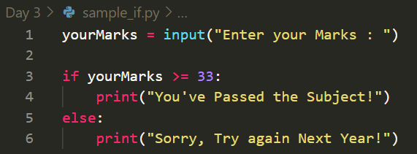
if Statement
An “if statement” is written by using the if keyword.
Indentation
Python relies on indentation (whitespace at the beginning of a line) to define scope in the code. Other programming languages often use curly-brackets for this purpose.

Slide 8
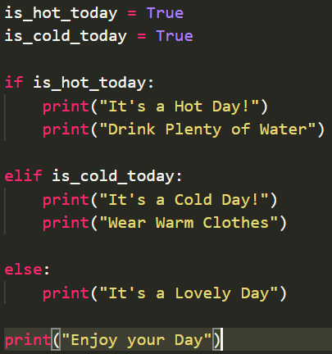
if..elif..else Statement
The elif keyword is pythons way of saying "if the previous conditions were not true, then try this condition".
The else keyword catches anything which isn't caught by the preceding conditions.
NOTE:
We can also have an else without the elif.

Slide 9
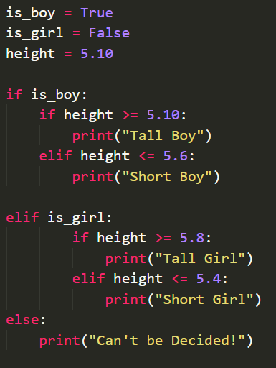
Nested if Statement
The phenomenon where we put “if statement” within another “if statement” is called as nested if statement.
The necessity of nested if can be mitigated using Logical Operators.

Slide 10
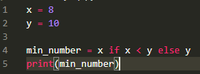
Ternary Operator
Ternary operators also known as conditional expressions are operators that evaluate something based on a condition being True or False.
Syntax:
[on_true] if [expression] else [on_false]
The answer to this is 8.

Slide 11
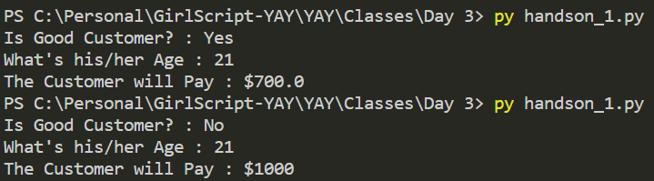
Handson Exercise - I
WAP where if a customer is regarded as good customer, and of age less than 18 then he'll get a discount of 50% from the MRP or if age is greater than equal to 65, then the discount is 40% or else, the discount % is 30%. But, if the customer is regarded as a bad customer and age below 18, then the discount is 20%, and if age greater than equal to 65, then its 10% else no discount. Find the price the customer will be paying after he get's a discount.
You can take the price of the item as $1000.
The Output should be somewhat like this.

Slide 12
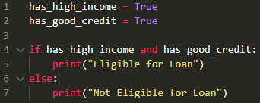

Logical Operators
Logical operators are used to combine conditional statements.
Logical Operators returns Boolean Value.
Operator | Description
and (&) | Returns True if both statements are true
or (|) | Returns True if one of the statements is true
not(~) | Reverse the result, returns False if the result is true
AND Operator.
NOT Operator.

Slide 13
Boolean Algebra
OR Operator
Operatation | Answer
0 OR 0 | 0
0 OR 1 | 1
1 OR 0 | 1
1 OR 1 | 1
AND Operator
Operatation | Answer
0 AND 0 | 0
0 AND 1 | 0
1 AND 0 | 0
1 AND 1 | 1

Slide 14
Boolean Algebra
NOT Operator
Operatation | Answer
NOT 0 | 1
NOT 1 | 0

Slide 15
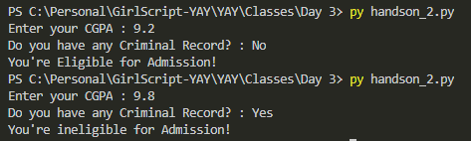
Handson Exercise - II
WAP if a student is having a good academic record (CGPA >= 9.0) along with no criminal record, he/she is eligible for admission in XYZ University else not.
Take input for criminal record as “Yes” or “No”.
The Output should be somewhat like this.

Slide 16
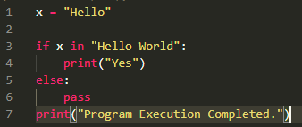
in and pass Operators
in : Returns True if a sequence with the specified value is present in the object
not in : It's just the opposite of in.
pass : The pass statement is used as a placeholder for future code.
When the pass statement is executed, nothing happens, but you avoid getting an error when empty code is not allowed.
Empty code is not allowed in loops, function definitions, class definitions, or in if statements.

Slide 17
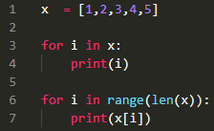

for Loops (Intuition)
A for loop is used for iterating over a sequence (that is either a list, a tuple, a dictionary, a set, or a string).
A Basic for loop
Ways to Loop over a container

Slide 18
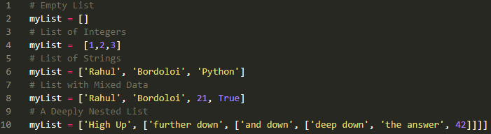
Python Lists
List is one of the most commonly used and popular Data Structure in Python.
A list is a collection which is ordered and changeable. In Python lists are written with square brackets.
Example different Lists Possible.

Slide 19
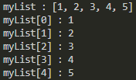

Python Lists
As discussed over in Strings, Python Lists follows the same priniciple of 0 and -1 indexing.
Indexing and Slicing strategies are same for all the data structures in python.
You can initialise a list using list() constructor call.
Slicing in Lists
Indexing in Lists

Slide 20
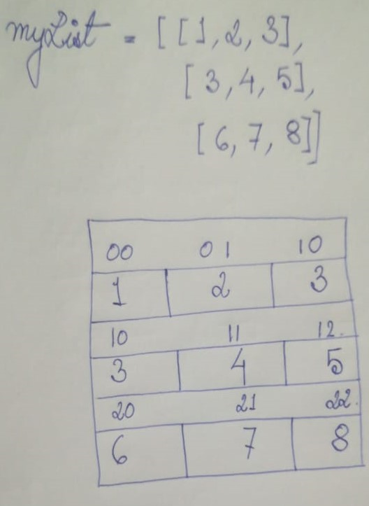
n-D Python Lists
A List can have n-numbers/dimensions of List inside it. Such lists are known as n-dimensional lists.
Example of a 2D List and it's representation in Memory.

Slide 21

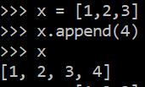
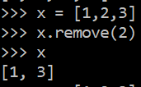
List Operations
Python has various in-built methods and functions to help us falicitate the operations we want to perform on a list.
Note :
Functions are general-purpose utility code that’s not specific to a particular data-type, whereas
Methods are general-purpose utility code that’s specific to a particular data-type.
Example 1 Example 2 Example 3

Slide 22
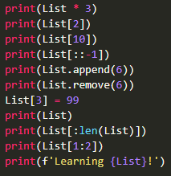
Answer These!
You're given a List :
Answer the Following Questions :

Slide 23

Handson Exercise - III
WAP to find the Maximum (Highest) Element of a 1D Integer List.
The Output should be somewhat like this.

Slide 24
Thank You
See you on Day 4!

